Slide 1
React & Redux
Presenters:
Karan Sheth, Manoj Sureddi

Slide 2
What is Front-end engineering?
Focused on building the UI (User interfaces) for the users of our website or web application
Few things we consider are
Accessibility
Aesthetics
Performance
Security
Quality of code
Notes:
Accessibility: Often overlooked on the web, we design our applications to cater for users with some form of disability. This could be some cognitive impairment or limited dexterity. Someone who struggles with clickable areas such as radio inputs or checkboxes is an example.
Aesthetics: The styles of our UI elements such as the buttons, the fonts, and the spacing. Recently we implemented a design system that enforces consistency across our products.
Performance: We have to think about the performance of our applications to keep page speeds fast. This involves reducing network requests, keeping images and SVG files optimized using methods like compression. The quicker you load that signup page, the more chance you have of users signing up. Eg: Lighthouse in by google
Security: Paramount. Tiny bugs in code can result in private information being leaked, and there are people out there hungry for it. Of course, it’s a huge topic.
Quality of code: We use code reviews to check each other's work. We require at least two approvals before anything can proceed to our live applications. We use coding standards that have to be followed across the whole of front-end. Github allows us to do this and more.

Slide 3
Why use a framework/library ?
Synchronization of state and view
Routing
A Template System
Reusable components
Notes:
Back in the day, web developers would implement front end logic by relying heavily on vanilla JS and jQuery. But, as front end applications became more and more complex, the tools rose to meet that complexity.
The frameworks that are popular today have a few core commonalities. Most front end frameworks/libraries, from Vue to React, provide some combination of the following:

Slide 4
What is React?
Notes:
First I’ll give a little background about what React is - React is a Javascript library that was created by Facebook (in around 2013) to create dynamic user interfaces for the web.
The key word here is dynamic, which means content on the page can change dynamically while you interact with it. In other words, the page doesn’t render just static HTML.
React is a JavaScript library for building user interfaces. It is the view layer for web applications.
At the heart of all React applications are components. A component is a self-contained module that renders some output. We can write interface elements like a button or an input field as a React component. Components are composable. A component might include one or more other components in its output.

Slide 5
Day 1
Introduction to JSX
Local Component State
Life-cycle methods
Unidirectional Data Flow Preview
Interactions with Forms and Events
Controlled Components
Smart/DumbComponents
Composable Components
Reusable Components
Styling Components

Slide 6
JSX - (J)ava (S)cript (X)ML
JSX stands for JavaScript XML. With React, it's an extension for XML-like code for elements and components.
JSX is a XML-like syntax extension to ECMAScript without any defined semantics
JSX is a preprocessor step that adds XML syntax to JavaScript. You can definitely use React without JSX but JSX makes React a lot more elegant.
Just like XML, JSX tags have a tag name, attributes, and children. If an attribute value is enclosed in quotes, the value is a string. Otherwise, wrap the value in braces and the value is the enclosed JavaScript expression.

Slide 7
JSX transpiling
React.createElement(Login, { foo: ..., bar: ... });
<Login foo={...} bar={...} />
Notes:
Show how babel transpiles to the javascript
We also recommend to verify that the CDN you are using sets the Access-Control-Allow-Origin: *

Slide 8
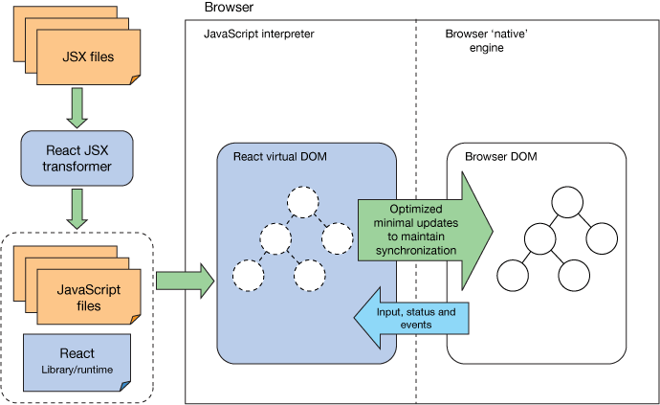
React Architecture

Slide 9
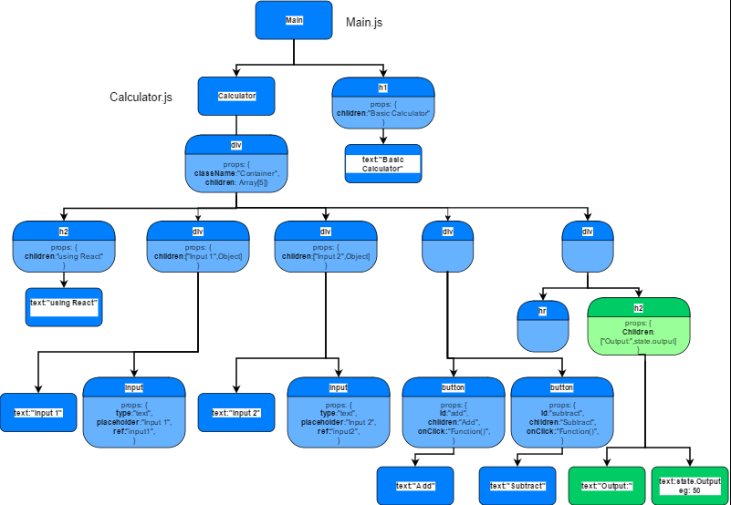
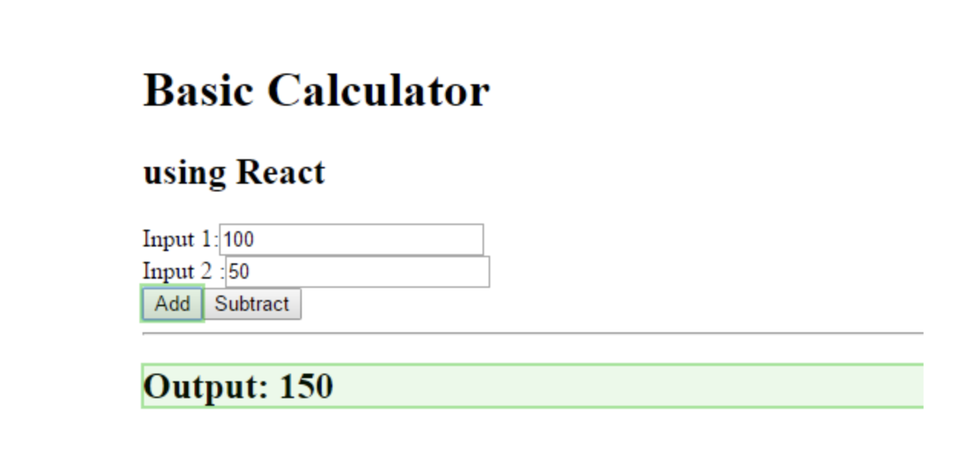
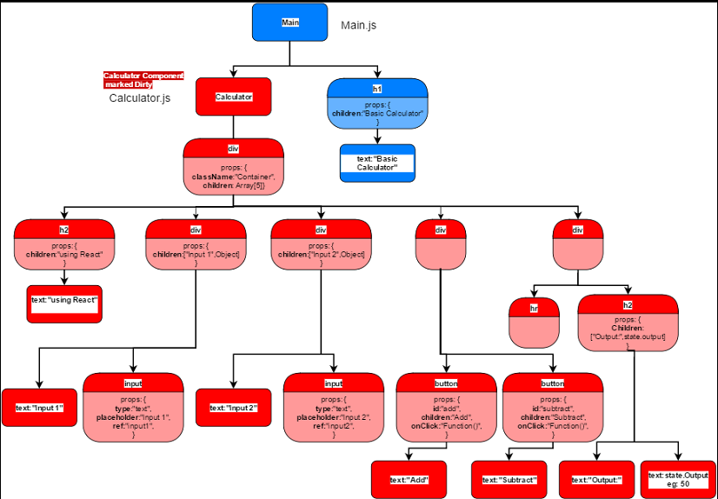
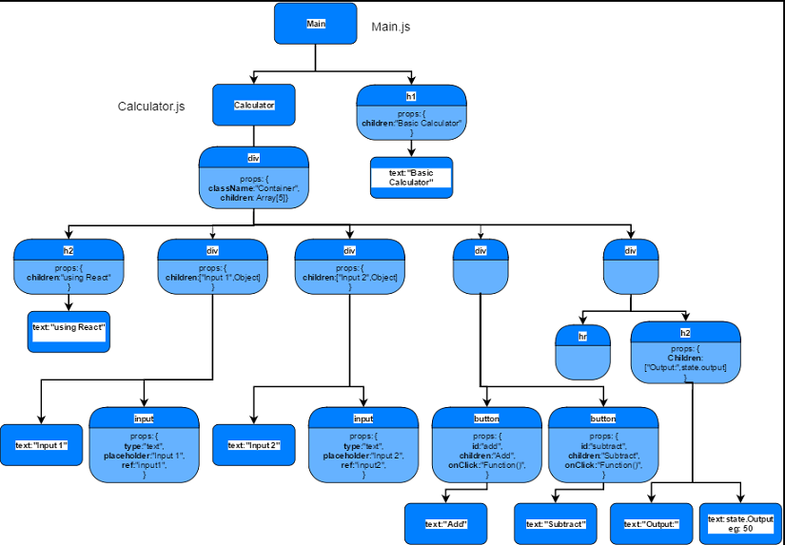
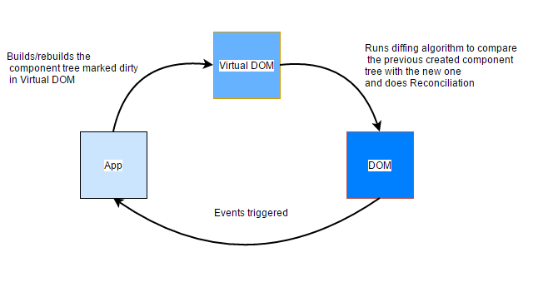
What is virtual DOM?
Notes:
Explain about critical rendering path
https://developers.google.com/web/fundamentals/performance/critical-rendering-path/render-tree-construction
After this start explaining code and after that move to each slide by telling what it is

Slide 10
Stateless functions
A functional(a.k.a. stateless) component is just a plain javascript function which takes props as an argument and returns a react element.
A stateless component has no state, it means that you can’t reach `this.state` inside it. It also has no lifecycle so you can’t use componentDidMount and other hooks
When react renders our stateless component all what it needs to do is just call MyStatelessComponent function and pass props there. That’s it.

Slide 11
Props
React allows us to pass information to a Component using something called props. Props are basically kind of global variable or object.
How to pass props:
How to access them:
<DemoComponent sampleProp = "HelloProp" />
this.props.propName

Slide 12
Unidirectional data flow
In general this concept means that data has one, and only one, way to be transferred to other parts of the application.
In React this means that:
state is passed to the view and to child components
actions are triggered by the view
actions can update the state
the state change is passed to the view and to child components
Notes:
The view is a result of the application state. State can only change when actions happen. When actions happen, the state is updated.
Changing state on a Component will never affect its parent, or its siblings, or any other Component in the application: just its children.
This is the reason that the state is often moved up in the Component tree, so that it can be shared between components that need to access it.

Slide 13
State
The state is an instance of React Component Class can be defined as an object of a set of observable properties that control the behaviour of the component. In other words, the State of a component is an object that holds some information that may change over the lifetime of the component.
You cannot set the state like
The webpage will not re-render itself because React State will not be able to detect the changes made.
You can also do something like
this.setState({attribute: newValue });
this.state.attribute = "new-value";
this.setState(function(prevState, props){
return {counter: prevState.count + props.diff};
});
Notes:
Now an interesting question
So react is same for web based react, react native and react test renderer
In the case of web based react app it updates dom
When it comes to react native it updates android or ios views
How do you think React.Component delegates handling state updates to the platform-specific code ?
If asked for explanation:
All react’s exports, such as React.Component, React.createElement, React.Children utilities and Hooks are independent of the target platform.
In contrast, the renderer packages expose platform-specific APIs like ReactDOM.render() that let you mount a React hierarchy into a DOM node.
Many renderers include a copy of the same code — we call it the “reconciler”
As the vast majority of React users only needs one renderer at a time, such as react-dom, a build step smushes the renderer code into one single bundle for better performance
The takeaway here is that the react package only lets you use React features but doesn’t know anything about how they’re implemented. The renderer packages (react-dom, react-native, etc) provide the implementation of React features and platform-specific logic. Some of that code is shared (“reconciler”) but that’s an implementation detail of individual renderers.

Slide 14
Life-cycle methods
Mounting:
constructor
componentWillMount
Static getDerivedStateFromProps
render
componentDidMount
Updating:
Static getDerivedStateFromProps
shouldComponentUpdate
render
getSnapshotBeforeUpdate
componentDidUpdate
Unmounting:
componentWillUnmount
Error:
getDerivedStateFromError
componentDidCatch
Notes:
Constructor:
The first thing that gets called is your component constructor, if your component is a class component
This does not apply to functional components.
The constructor gets called with the component props.
You must call super and pass in the props. Because the parent class instance should be updated with the props before the child is accessing this in the constructor.
This can be overcome using public fields
getDerivedStateFromProps
When mounting, getDerivedStateFromProps is the last method called before rendering.
You can use it to set state according to the initial props.
The advantage of getDerivedStateFromProps is that it is more intuitive—it’s only meant for setting state, whereas a constructor has multiple uses.
Show some code
componentDidmount
After we’ve rendered our component for the first time, this method is called.
You can’t guarantee the AJAX request won’t resolve before the component mounts. If it did, that would mean that you’d be trying to setState on an unmounted component, which not only won’t work, but React will yell at you for. Doing AJAX in componentDidMount will guarantee that there’s a component to update.
shouldComponentUpdate:
We have new props. Typical React dogma says that when a component receives new props, or new state, it should update.
But our component is a little bit anxious and is going to ask permission first.
Here’s what we get — a shouldComponentUpdate method, called with nextProps as the first argument, and nextState is the second.
shouldComponentUpdate should always return a boolean — an answer to the question, “should I re-render?” Yes, little component, you should. The default is that it always returns true.
The is an excellent place to do some performance tweaks to you application to reject unnecessary updates
getSnapshotBeforeUpdate
Note it’s called between render and the updated component actually being propagated to the DOM. It exists as a last-chance-look at your component with its previous props and state.
Well, there may be a delay between calling render and having your changes appear. If you need to know what the DOM is exactly at the time of integrating the result of the latest render call, here’s where you can find out.
componentDidUpdate
In componentDidUpdate, we have access to three things: the previous props, the previous state, and whatever value we returned from getSnapshotBeforeUpdate.
getDerivedStateFromError
We want to show an error screen. The easiest way to do so is to have a value like this.state.hasError, which gets flipped to true at this point.
componentDidCatch
Very similar to the above, in that it is triggered when an error occurs in a child component.
The difference is rather than updating state in response to an error, we can now perform any side effects, like logging the error.
Note that componentDidCatch only works for errors in the render/lifecycle methods. If your app throws an error in a click handler, it will not be caught.

Slide 15
Control components
In HTML, form elements such as <input>, <textarea>, and <select>typically maintain their own state and update it based on user input. In React, mutable state is typically kept in the state property of components, and only updated with setState().
We can combine the two by making the React state be the “single source of truth”. Then the React component that renders a form also controls what happens in that form on subsequent user input
Notes:
Show them the controlled component code Form.html and follow the instructions written

Slide 16
Smart/DumbComponents
Dumb Components
Dumb components are also called ‘presentational’ components because their only responsibility is to present something to the DOM.
Smart Components
Smart components (or container components) on the other hand have a different responsibility.
Notes:
Dumbcomponent:
Once that is done, the component is done with it. No keeping tabs on it, no checking in once in a while to see how things are going. Nope. Put the info on the page and move on.
Smart component:
Because they have the burden of being smart, they are the ones that keep track of state and care about how the app works.
Show Dumbcomponent.jsx
Show controlled component itself as it is a smart component

Slide 17
Workshop
Simple Todo Application
Simple Calculator

Slide 18

Questions

Slide 19
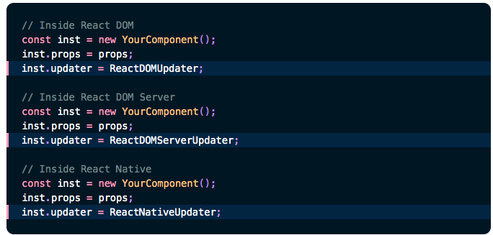
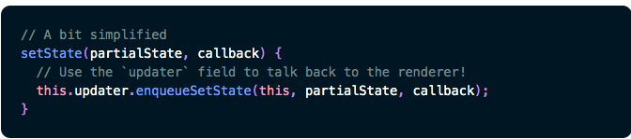
Answer
Notes:
If asked for explaination:
All react’s exports, such as React.Component, React.createElement, React.Children utilities and Hooks are independent of the target platform.
In contrast, the renderer packages expose platform-specific APIs like ReactDOM.render() that let you mount a React hierarchy into a DOM node.
Many renderers include a copy of the same code — we call it the “reconciler”
As the vast majority of React users only needs one renderer at a time, such as react-dom, a build step smushes the renderer code into one single bundle for better performance
The takeaway here is that the react package only lets you use React features but doesn’t know anything about how they’re implemented. The renderer packages (react-dom, react-native, etc) provide the implementation of React features and platform-specific logic. Some of that code is shared (“reconciler”) but that’s an implementation detail of individual renderers.

Slide 20
Day 2
Higher order components
Stateless functions
Debugging react through chrome
Workshop

Slide 21
Create-react-app
Setting up the tools to develop a React application can be intimidating and time-consuming. There are a lot of moving parts. For example, setting up Babel to transpile JSX into browser-ready code, and configuring Webpack to bundle your project assets.
Create React App is a tool (built by developers at Facebook) that gives you a massive head start when building React apps. It saves you from time-consuming setup and configuration. . You simply run one command and Create React App sets up the tools you need to start your React project.
npm install -g create-react-app. Or yarn global add create-react-app
create-react-app --version
create-react-app hello-world

Slide 22
Configuration
The tools required for building a react app
Webpack
Babel
React

Slide 23
Babel
Babel is a JavaScript compiler that can translate markup or programming languages into JavaScript. Basically feature that are not available in current JS version are complied to the current version.
Take the new fat arrow function for example:
As for why does it understand JSX and React. It's because React comes with the default set of syntax-transformers that ship with Babel.
let myFunc = () => {
console.log("ES6 is awesome!");
};
var myFunc = function() { console.log("ES6 is awesome!"); };
Notes:
Show them a live transpilation using babels playground
Show jsx to javascript
Also es6 to es5

Slide 24
Webpack
Webpack is a module bundler. Webpack can take care of bundling alongside a separate task runner.
Sometimes webpack plugins are used to perform tasks that are usually done outside of webpack, such as cleaning the build directory or deploying the build.
React, and Hot Module Replacement (HMR) helped to popularize webpack
The smallest project you can bundle with webpack consists of input and output. The bundling process begins from user-defined entries. Entries themselves are modules and can point to other modules through imports.

Slide 25
Higher order components
A higher-order component (HOC) is an advanced technique in React for reusing component logic. HOCs are not part of the React API, per se. They are a pattern that emerges from React’s compositional nature.
Concretely, a higher-order component is a function that takes a component and returns a new component.
Whereas a component transforms props into UI, a higher-order component transforms a component into another component.
Notes:
Show how higher order components work

Slide 26
Accessing API with react

Slide 27
Workshop time !!
TODO App with child todos
Sudoku
Online Shopping catalog with cart
Timeline with like and comment
2048 app
Tetris
Github battle - Battle two Github users and see the most popular Github projects for any language.

Slide 28
Questions

Slide 29
Redux (the What and the Why)
The What
Redux is one of the libraries that helps you implement sophisticated state management in your application. It goes beyond the local state (e.g. React’s local state) of a component. It is one of the solutions you would take in a larger application in order to tame the state. A React application is a perfect fit for Redux, yet other libraries and frameworks highly adopted its concepts as well.
“Redux is a predictable state container for JavaScript apps.”
The Why
Notes:
Why redux
Ask them about what problems they faced in the previous work shop session and then explain why redux ?
In React, the principle of the unidirectional data flow became popular. State management should be more predictable in order to reason about it. Yet, the local state management wasn’t sufficient anymore eventually.

Slide 30
Basic components of redux
The basic components of redux
Store
Action
Reducer
View -> Action -> Reducer(s) -> Store -> View
Redux uses multiple Reducers. Basically, Reducers pick up the information from Actions and “reduce” the information to a new state, along with the old state, that is stored in the Store. When state in the Store is changed, the View can act on this by subscribing to the Store.

Slide 31
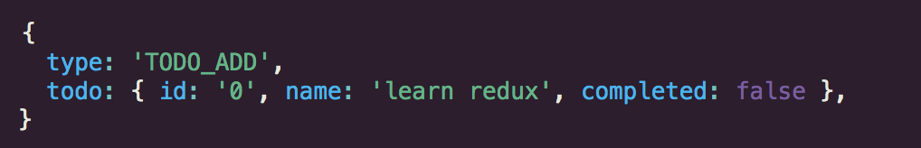
Action
An action in Redux is a JavaScript object. It has a type and an optional payload. The type is often referred to as action type. While the type is a string literal, the payload can be anything from a string to an object.

Slide 32
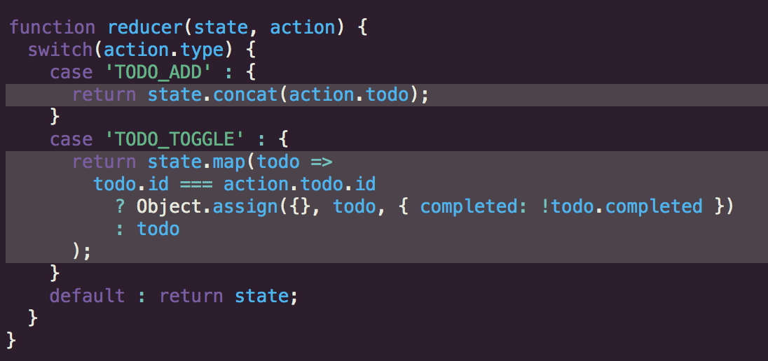
Reducer
A reducer is the next part in the chain of the unidirectional data flow. The view dispatches an action, an action object with action type and optional payload, which passes through all reducers.
A reducer is a pure function. It always produces the same output when the input stays the same. It has no side-effects, thus it is only an input/output operation. A reducer has two inputs: state and action. The state is always the global state object from the Redux store. The action is the dispatched action with a type and optional payload.

Slide 33
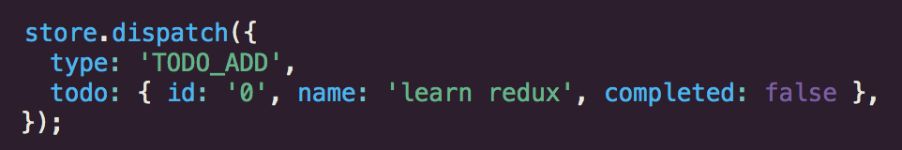
Store
The store holds one global state object. There are no multiple stores and no multiple states. The store is only one instance in your application. In addition, it is the first library dependency you encounter when using Redux.
import { createStore } from 'redux’;
const store = createStore(reducer);
the createStore takes a second optional argument: the initial state.
const store = createStore(reducer, []);
Dispatch actions:

Slide 34
Connect
Notes:
The connect() function connects a React component to a Redux store.
It provides its connected component with the pieces of the data it needs from the store, and the functions it can use to dispatch actions to the store.
It does not modify the component class passed to it; instead, it returns a new, connected component class that wraps the component you passed in.
The mapStateToProps and mapDispatchToProps deals with your Redux store’s state and dispatch, respectively. state and dispatch will be supplied to your mapStateToProps or mapDispatchToPropsfunctions as the first argument.
The returns of mapStateToProps and mapDispatchToProps are referred to internally as stateProps and dispatchProps, respectively. They will be supplied to mergeProps, if defined, as the first and the second argument, where the third argument will be ownProps. The combined result, commonly referred to as mergedProps, will then be supplied to your connected component.

Slide 35
Workshop Time

Slide 36
Questions

